Slide 1
Static Code Analyzer
Name: Kamruzzaman Asif
Exam Roll: 60928
Supervisor Name: Dr. Kazi Muheymin-Us-Sakib
Professor, IIT, DU

Slide 2
Table of Contents
01. Project Description
02. Motivation
03. Working Methodology
04. Technology
05. Results
06. Challenges

Slide 3
Project Description
1

Slide 4
Project Description
This is a software tool that analyzes ‘C’ source codes and shows the metrics (such as LOC and Halstead Complexity metrics) and detects syntactic code clones.

Slide 5
Motivation
2

Slide 6
Motivation
Static analysis of source code is very important and useful analysis for software quality and security. Software developers should use static code analysis for a better understanding of the software, code simplification and sanitizing, identifying potential bugs, maintaining coding standards, improving application performance, better resource utilization, etc.

Slide 7
Working Methodology
3

Slide 8
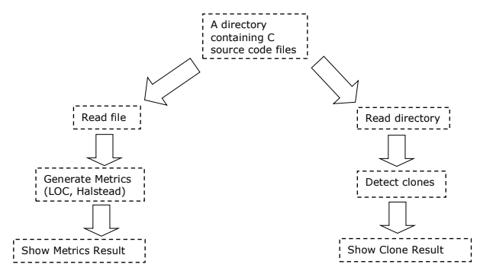
Overview of The Full Project

Slide 9
LOC Metrics
LOC Metrics
Number of Blank Lines
Number of Physical Lines
Number of Logical Statements
Number of Comment Lines
Number of Comment and Statement Lines
Number of Statement Lines

Slide 10
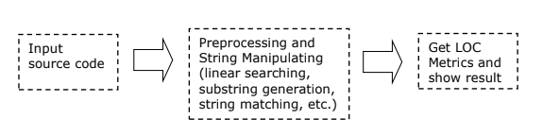
LOC Metrics
Figure: LOC counting Process

Slide 11
Halstead Metrics
Halstead Metrics
the number of distinct operators(n1)
the number of distinct operands(n2)
the total number of operators(N1)
the total number of operands(N2)
Halstead Measures
Program vocabulary : n = n1+n2
Program length : N=N1+N2
Calculated program length : _N = n1*log(2)n1 + n2*log(2)n2
Volume : V= N * log(2)n
Difficulty : D = n1/2 * N2/n2
Effort : E = D * V
Time Required To Program : T = E/18 seconds
Number of delivered bugs : B = E^(2/3) / 3000 or B =V/3000

Slide 12
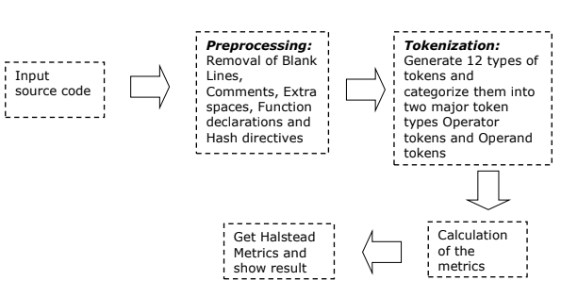
Halstead Metrics
Figure: Halstead Metrics working methodology

Slide 13
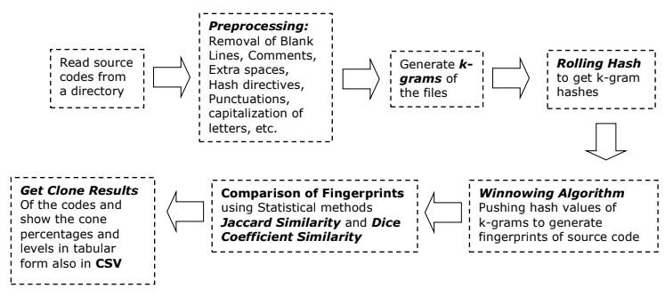
Code Clone Detection
Figure: Clone Detection Process

Slide 14
Technology
4

Slide 15


Technology

Slide 16
Results
5

Slide 17
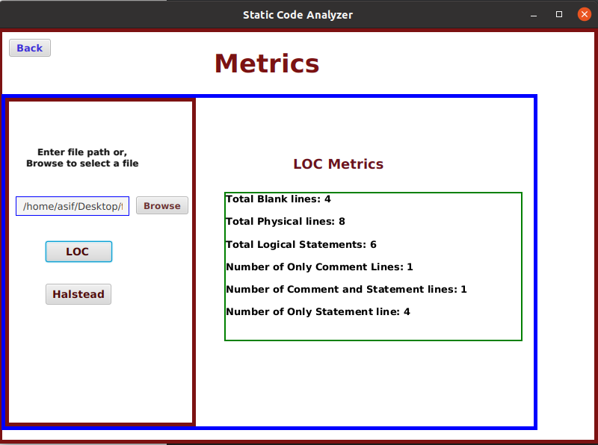
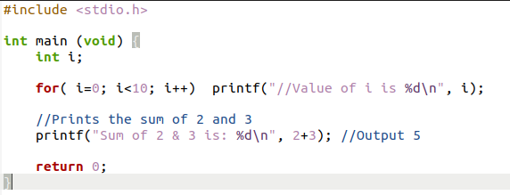
LOC Result

Slide 18
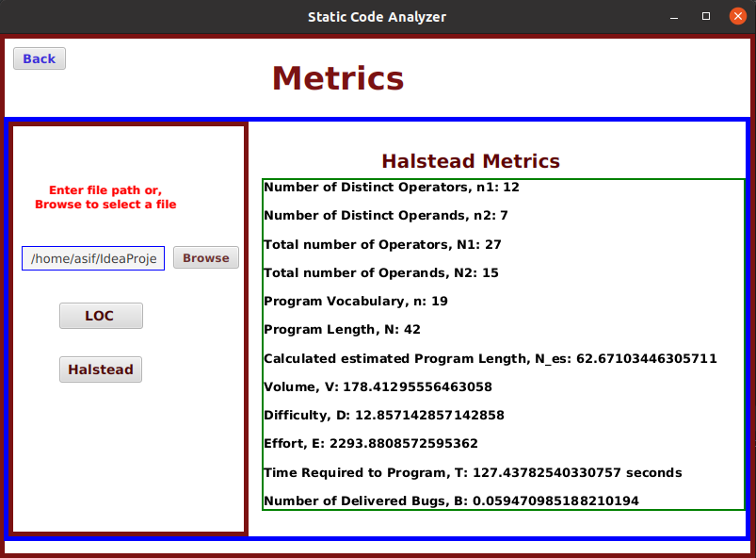
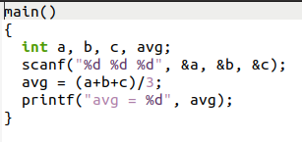
Halstead Result

Slide 19
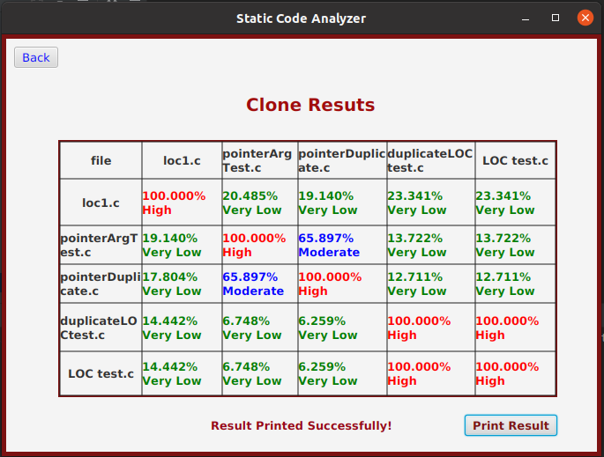
Clone Result
input directory: https://github.com/KamruzzamanAsif/SPL-1/tree/main/SCA_GUI/src/main/resources/FinalTest/Clone-Test

Slide 20
Challenges
6

Slide 21
Challenges
Challenges:
Preprocessing and other manipulation of code
Tokenization of source code
Halstead measures
Implementation of winnowing algorithm
Hashing, and Fingerprinting
Statistical analysis (Jaccard similarity, Dice similarity coefficient)
Implementing GUI with JavaFX
Clone Result printing in CSV format

Slide 22
Thank You
GitHub repository: https://github.com/KamruzzamanAsif/SPL-1

